Slide 1
Runge-Kutta 2nd Order Method
by
Dr. Md. Rajibul Islam
CSE, UAP

Slide 2
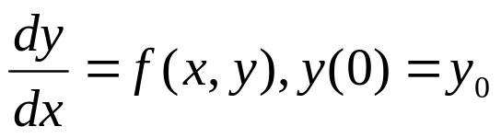




Runge-Kutta 2nd Order Method
For
As you can see the first two terms of the Taylor series
are the Euler’s method.
Runge-Kutta took this particular expression and equated it to the second-order . . . the first three terms of the Taylor series expansion for y
Runge Kutta 2nd order method is given by
where

Slide 3
Runge-Kutta 2nd Order Method
what they found out is that they got three equations as follows:
a₁+a₂=1……(1)
a₂p₁=1/2 ……(2)
a₂q₁₁=1/2 ……(3)

Slide 4

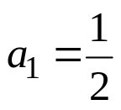



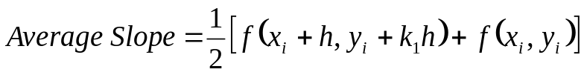
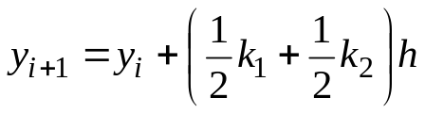


Heun’s Method
Heun’s method
y
Here a₂=1/2 is chosen
y_{i+1,} predicted
resulting in
y_{i}
x_{i}
x_{i+1}
x
where
Figure 1 Runge-Kutta 2nd order method (Heun’s method)

Slide 5


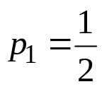
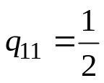


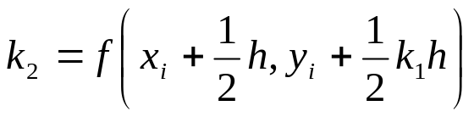
Midpoint Method
Here
is chosen, giving
resulting in
where

Slide 6
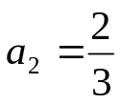
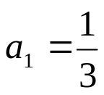
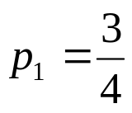
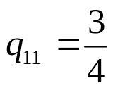
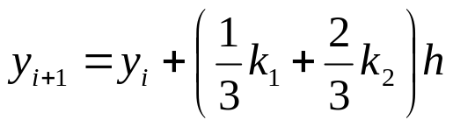
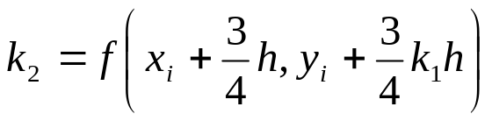
Ralston’s Method
Here
is chosen, giving
resulting in
where

Slide 7
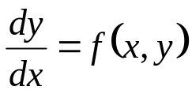
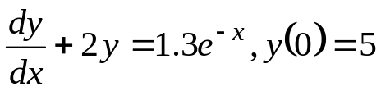
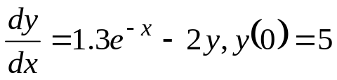

How to write Ordinary Differential Equation
How does one write a first order differential equation in the form of
Example
is rewritten as
In this case

Slide 8
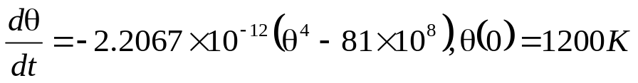


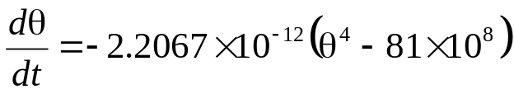
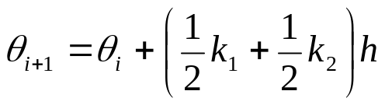
Example
A ball at 1200K is allowed to cool down in air at an ambient temperature of 300K. Assuming heat is lost only due to radiation, the differential equation for the temperature of the ball is given by
Find the temperature at
seconds using Heun’s method. Assume a step size of
seconds.

Slide 9

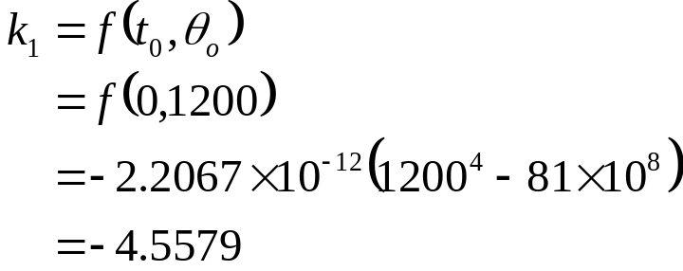
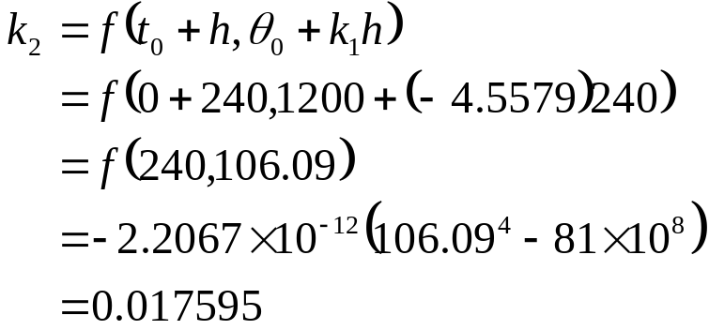
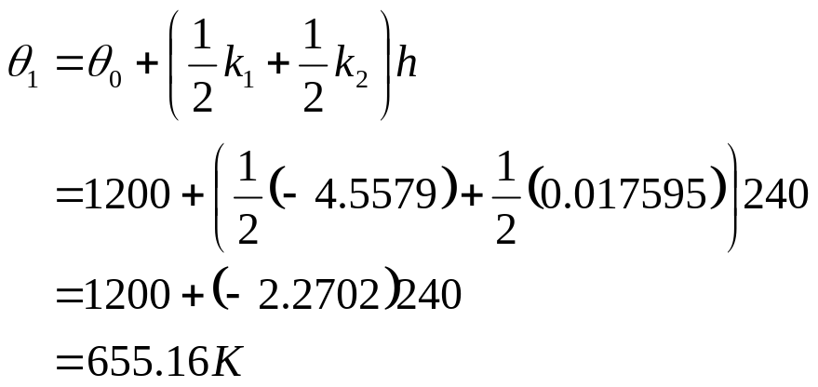
Solution
Step 1:

Slide 10
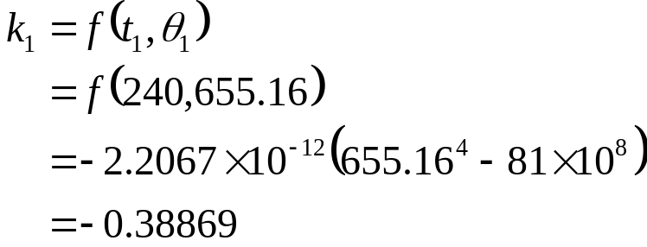
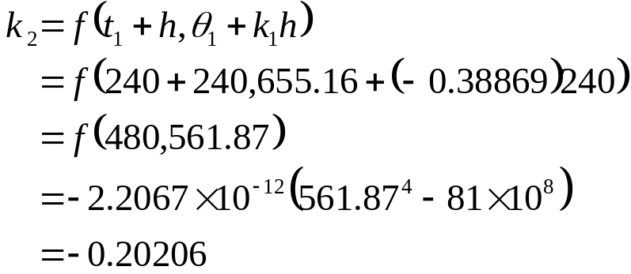
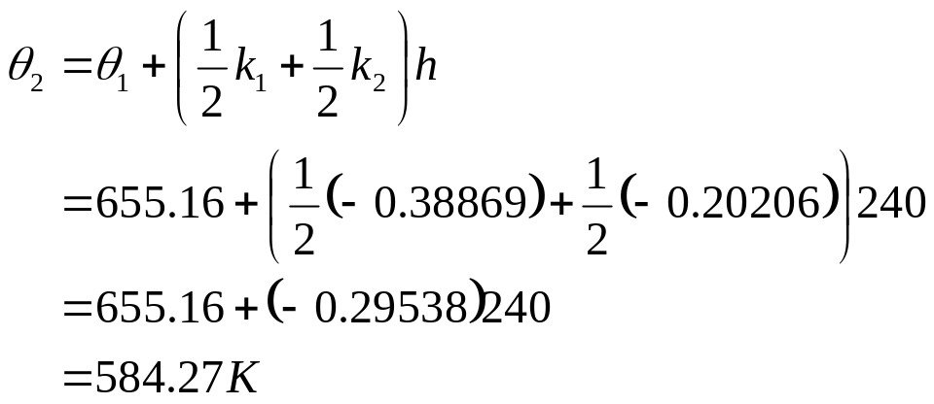
Solution Cont
Step 2:

Slide 11

Solution Cont
The exact solution of the ordinary differential equation is given by the solution of a non-linear equation as
The solution to this nonlinear equation at t=480 seconds is

Slide 12
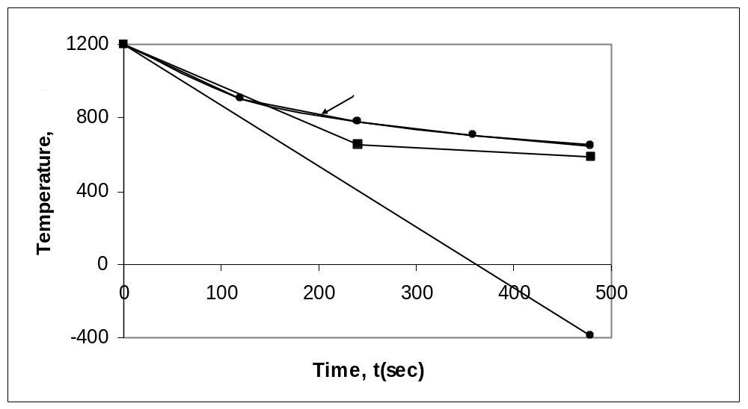
Comparison with exact results
Figure 2. Heun’s method results for different step sizes

Slide 13
Effect of step size
Table 1. Temperature at 480 seconds as a function of step size, h
Step size, h | θ(480) | E_{t} | |є_{t}|%
480 240 120 60 30 | −393.87 584.27 651.35 649.91 648.21 | 1041.4 63.304 −3.7762 −2.3406 −0.63219 | 160.82 9.7756 0.58313 0.36145 0.097625
(exact)

Slide 14
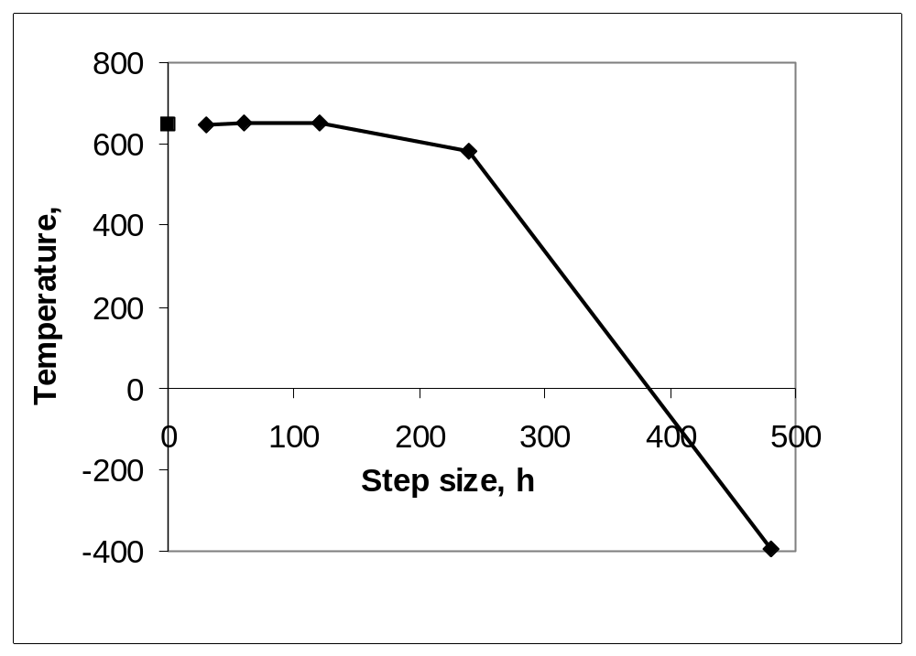
Effects of step size on Heun’s Method
Figure 3. Effect of step size in Heun’s method

Slide 15
Comparison of Euler and Runge-Kutta 2nd Order Methods
Table 2. Comparison of Euler and the Runge-Kutta methods
Step size, h | θ(480)
 | Euler | Heun | Midpoint | Ralston
480 240 120 60 30 | −987.84 110.32 546.77 614.97 632.77 | −393.87 584.27 651.35 649.91 648.21 | 1208.4 976.87 690.20 654.85 649.02 | 449.78 690.01 667.71 652.25 648.61
(exact)

Slide 16

Comparison of Euler and Runge-Kutta 2nd Order Methods
Table 2. Comparison of Euler and the Runge-Kutta methods
Step size, h
 | Euler | Heun | Midpoint | Ralston
480 240 120 60 30 | 252.54 82.964 15.566 5.0352 2.2864 | 160.82 9.7756 0.58313 0.36145 0.097625 | 86.612 50.851 6.5823 1.1239 0.22353 | 30.544 6.5537 3.1092 0.72299 0.15940
(exact)

Slide 17
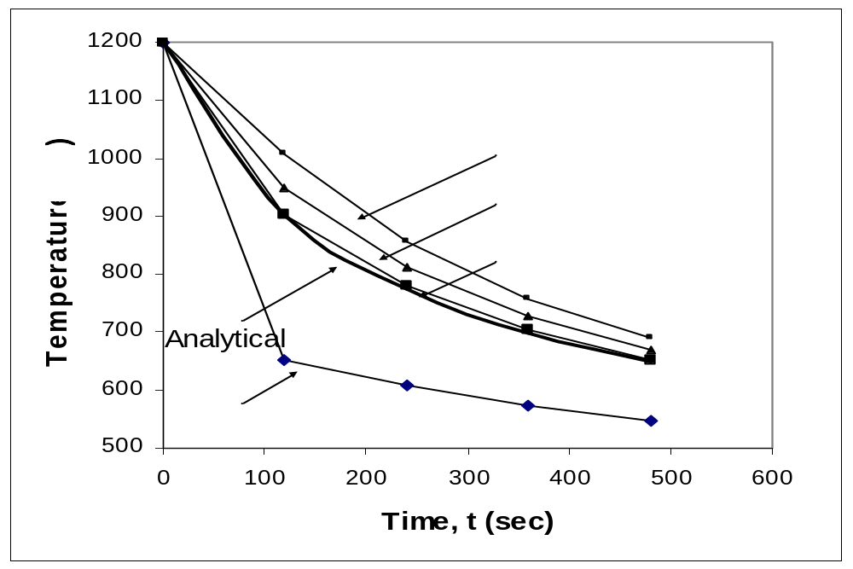
Comparison of Euler and Runge-Kutta 2nd Order Methods
Figure 4. Comparison of Euler and Runge Kutta 2nd order methods with exact results.

Slide 18
THE END

